Slide 1
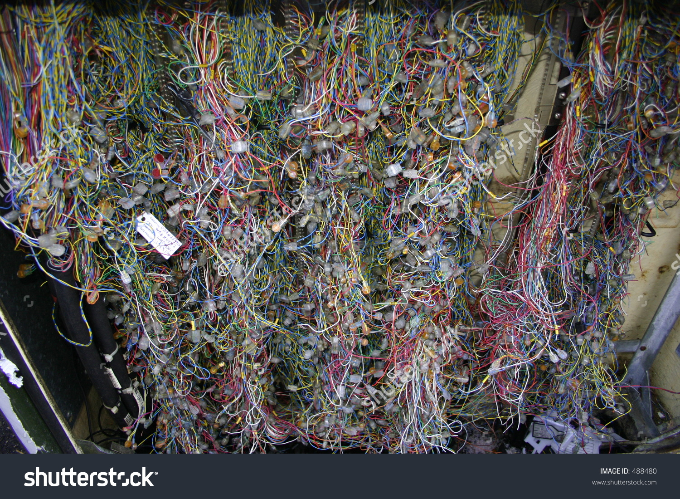
Neuroscience of social behaviour: introduction 1
Dr Will Norton: whjn1@le.ac.uk
The soup and the sparks: Neuromodulators, brain and behaviour
Notes:
Turn up the volume!

Slide 2
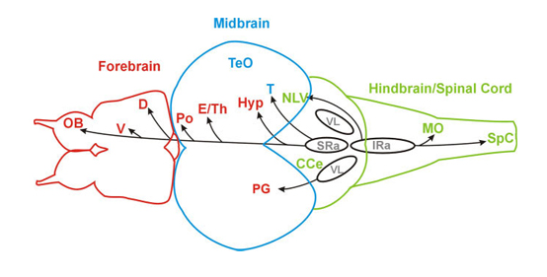
How does the brain control behaviour?
Visual processing
Stimulus processing
ANS
Peripheral feedback
Motor output
Visual input
Modulation of neural circuits that control social behaviour

Slide 3
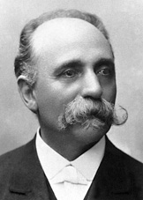
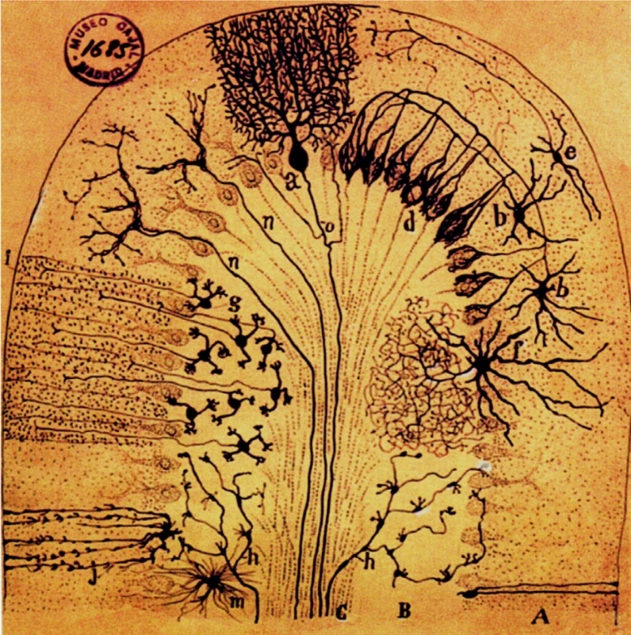
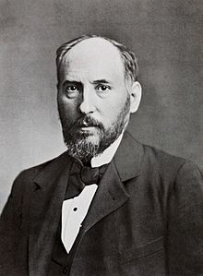
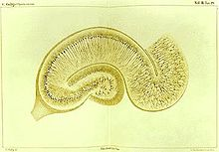
Reticular and neural theories of the brain
Camillo Golgi
Santiago
Ramon y Cajal
Brain is made up of discrete cells that form circuits
Notes:
Reticular theory of the brain. Single network of nerve fibres, not made up cells. Activity throughout network is important

Slide 4
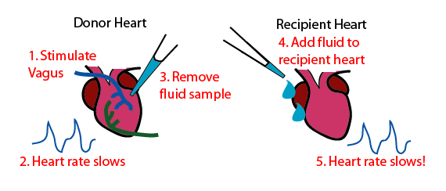
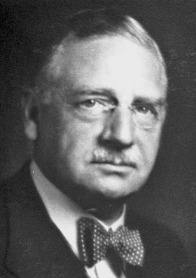
Acetylcholine: the first neurotransmitter
Slowed first heart by electrical stimulation. Collected Ringer’s saline
solution and applied it to second heart
Discovered “Vagusstoff” (acetylcholine):
chemical neurotransmission
Otto Loewi
https://commons.wikimedia.org/w/index.php?curid=2385256
Notes:
So neurotransmission requires CHEMICAL as well as electrical signalling. Galvani stimulated frog legs and made them twitch

Slide 5
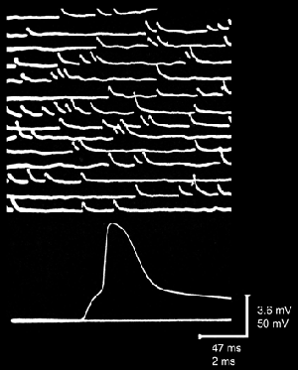
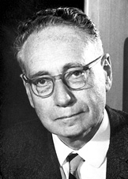
Release of neurotransmitters is quantal
Applied Acetylcholine to the frog neuromuscular junction and recorded
excitatory post-synaptic potentials
Neurotransmitter signalling is quantal: discrete release
and termination – existence of synaptic vesicles
Bernard Katz
Notes:
Acetylcholine shown to be a neurotransmitter at the neuromuscular junction – released in measurable small amounts, “quanta”

Slide 6
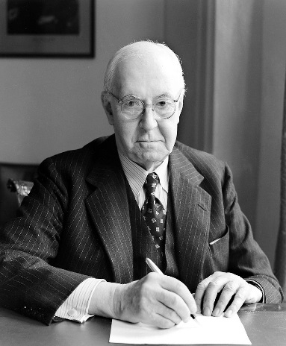
Dale’s principle
Henry Hallett Dale proposed that each neuron can only release
one neurotransmitter:
wording of the principle was ambiguous
only two neurotransmitters known at the time
We now know that multiple transmitters are released at the same
synapse
Henry Dale

Slide 7
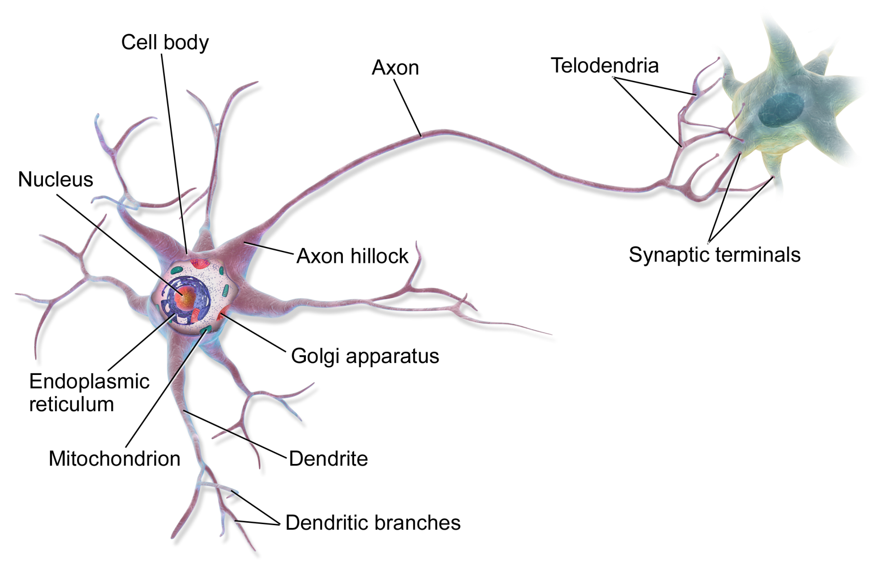
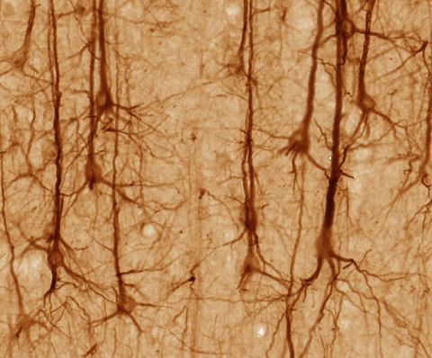
Structure of a typical neuron
Notes:
Movement of information from electrical to chemical signalling. Synapses found very close to each other.

Slide 8
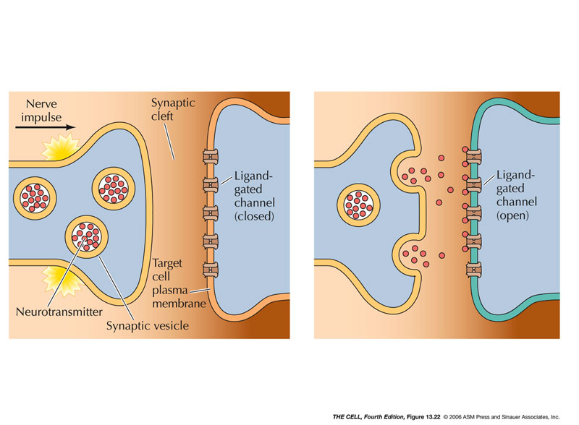
Classic synaptic neurotransmitter signalling
Cartoon showing a synapse before and after neurotransmitter release
Information flows in one direction (neuron – synapse)
Combination of electrical and chemical signalling
Image from “The Cell”, ASM Press
Notes:
Luigi Galvani stimulated dead frog’s legs with electricity and made them twitch

Slide 9
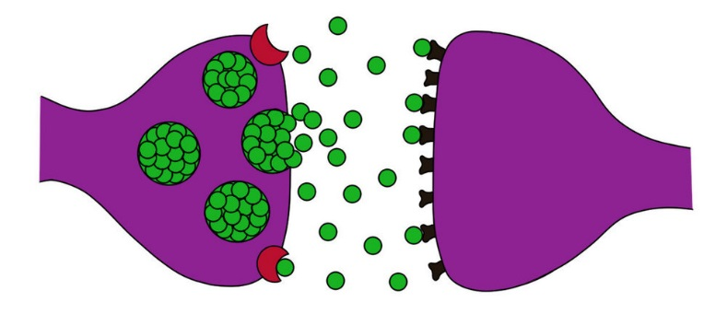
Characteristics of synaptic neurotransmission
Neurotransmitters synthesised within neuron
Neurotransmitters packaged into vesicles and stored
Neurotransmitters released upon demand (vesicles fuse to
presynaptic membrane upon depolarisation by an action
potential; calcium dependent). Fast transmission
Transmitters bind receptors (typically ligand-gated ion channels)
on postsynaptic membrane of a single neuron
Transmitters re-uptaken by transporters
and repackaged into vesicles (recycling)
Notes:
Note that reuptake is important rather than de novo synthesis – dat ko mice cant take up DA and global levels of DA in presynapse decreases

Slide 10
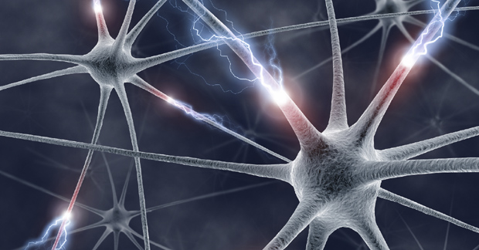
Volume neurotransmission
Neuromodulation is the physiological process by which a given
neuron uses one or more chemicals to regulate diverse populations
of neurons
Includes neurotransmitters, neuropeptides and hormones that have
widely distributed, temporally extended effects on neurons and circuits
Stylised image of neurons firing
Notes:
Goes back to reticular theory – as if brain acts like a connected net rather than discrete signalling units

Slide 11
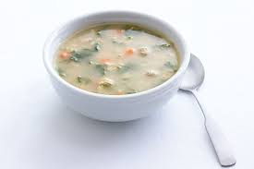
Neuromodulators: “volume neurotransmission”
Can diffuse through large areas of the nervous system to affect
multiple neurons
Can act at the pre- and postsynapse as well as on dendrites and soma.
Important role in modulating release of (other) neurotransmitters
Typically bind to G-protein coupled receptors and act slowly
Position of receptor will determine activity (time needed to diffuse)
Can fine-tune the activity of entire neural networks
and allow cross-talk between different neurons
A bowl of soup

Slide 12
Subcortical circuits affected by neuromodulation
Network diagram of connections between
subcortical brain areas
5-HT: threat assessment
Acetylcholine: attention
Dopamine: reward
Histamine: arousal
Noradrenaline: novelty and saliency
Krichmar, 2008
Notes:
Linked to basic emotional processes. Neuromodulators can alter the background level of all of these

Slide 13
Example of a volume neurotransmitter: dopamine
Dopamine is re-uptaken by the dopamine transporter protein DAT on
the presynaptic membrane
Compared to other neurotransmitters (e.g. glutamate) numbers of DAT
are low. They are clustered at the presynpatic membrane and have
a slow reaction time
This means that a large amount of DA can escape the synapse =>
volume transmission is the primary mode of signalling!
Diffusion is the main mechanism that limits DA signalling – as
dopamine diffuses it will decrease to a concentration that is unable
to activate synapses
DAT acts to control the timing and area of diffusion,
thus tailoring cross-talk between different neurons
Cragg and Rice, 2004
Notes:
High and low affinity receptors exist. High affinity (D1) receptor activity is influenced by DAT. Low affinity (D2R) is not – since DAT cannot alter the concentration of DA to a large extent

Slide 14
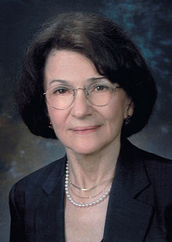
Attention modified by DA:NA balance – turn up the noise!
Attention level (executive function) is modified by the balance
between dopamine and noradrenaline in the prefrontal cortex
Moderate levels of NA act on the PFC to increase the response to
stimulation (“signal”), whereas levels of DA act to decrease
background “noise”
Small fluctuations in DA and NA can dramatically affect the
neural circuits that control attention, arousal and
executive function
Arnsten and Goldman-Rakic, 1990
Patricia Goldman-Rakic

Slide 15
How do neural circuits control behaviour?
Initially, each behaviour was thought to be driven by a dedicated
neural circuit in the brain
However, recent research suggests that discrete behaviours can
be produced by the interaction of diffuse neural networks with
overlapping functions:
Different behaviours can be driven by the same neurons
acting in parallel circuits
Rather than being hard-wired entities, neural circuits exhibit
plasticity due to short-term neuromodulatory activity and
longer-term structural reorganization at the synaptic level
Zupanc and Lamprecht, 2000; Bargmann 2012

Slide 16
Behaviour controlled by differential activation of nodes
Image showing activation of different nodes in the brain
Newman, 1999

Slide 17
The social decision-making network (SDMN)
Controls social behaviour in the vertebrate brain and is conserved
across different species
Interacts with the
mesolimbic reward
system to control
reaction to salient
stimuli
Diagram showing connections between reward
Pathway and social decision making network
O’Connell and Hoffmann 2012

Slide 18
Measuring contribution of SDM to social behaviour
Neuromodulators are well-placed to modify the activity of
neural circuits – act on multiple nodes at same time
Remove function of the neuromodulator and measure behaviour
Compare activation of SDM to non-manipulated fish
Diagram of SDMN

Slide 19
Summary
Neurotransmitters can act both synaptically and by volume
neurotransmission
Neuromodulation alters the tone of circuits in the brain
Neural circuits likely act through combined activity of nodes to
control multiple behaviours rather than altering a single behaviour
Network activity can be measured by IEG activation or live imaging;
imaging can occur on free-swimming or restrained animals

Slide 20
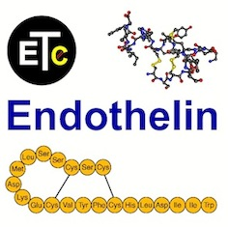
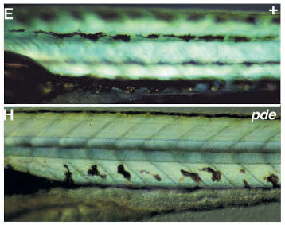
Next lecture: neuroscience of social behaviour, intro 2
Focus on endothelin (ET), a neuromodulator
Examine link between ET and the social decision making network
Notes:
21 AA peptide that was first discovered as having a role in the controlling vessel contraction.

